Slide 1
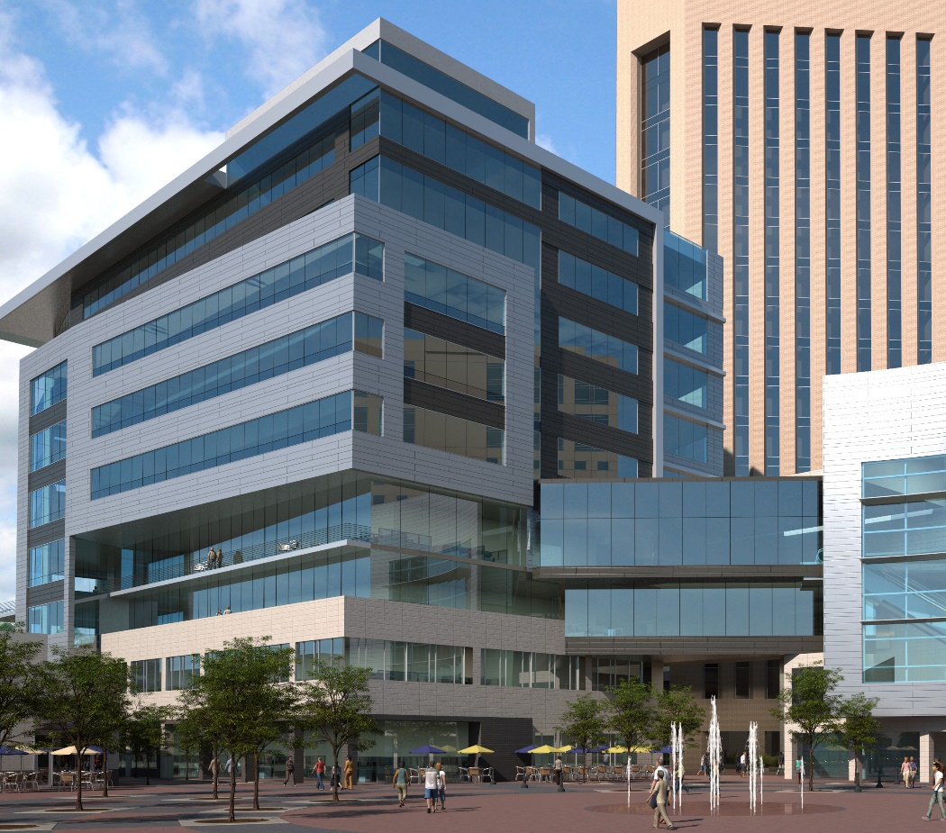
City Center Plaza
Home for the Computer Science department
2nd and 3rd floors of City Center Plaza Building
42,000 sq. ft. space
Offices for 26+ faculty
5 classrooms
2 tutoring/computer labs
Research labs
Public trans. straight to the building, shuttle to/from main campus, bike storage
Notes:
http://news.boisestate.edu/update/2014/06/24/computer-science-program-moving-downtown-boise/

Slide 2
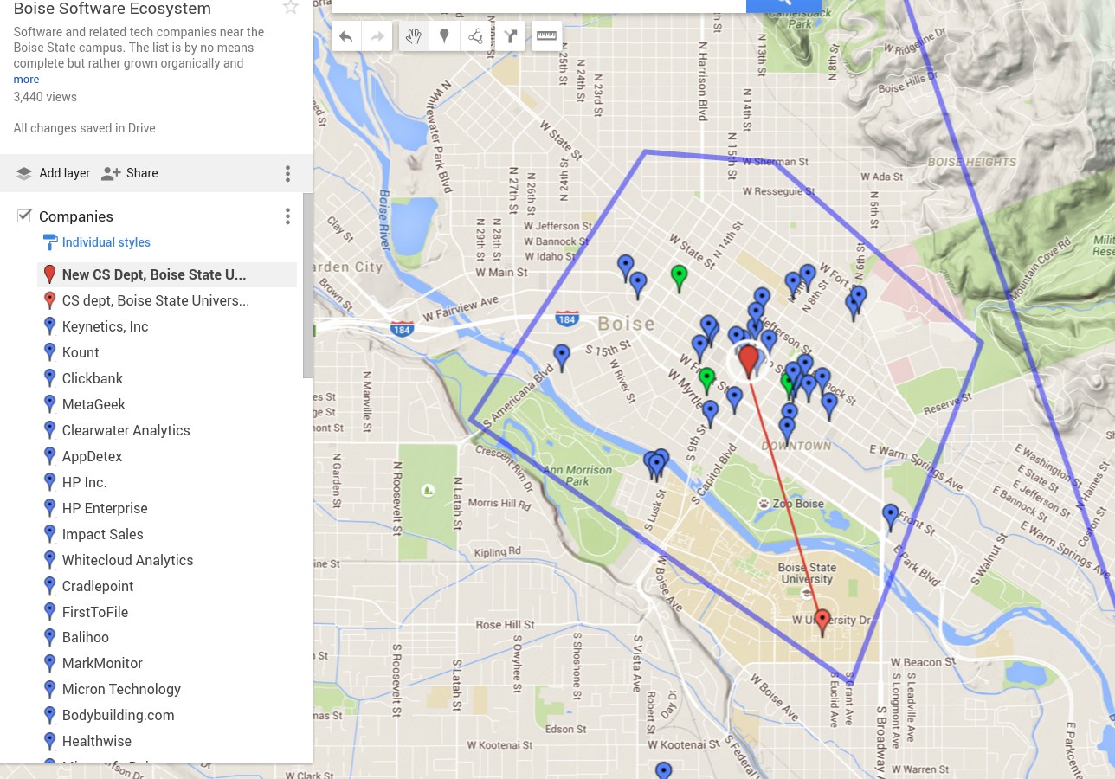
Boise Software Ecosystem
Notes:
http://news.boisestate.edu/update/2014/06/24/computer-science-program-moving-downtown-boise/

Slide 3


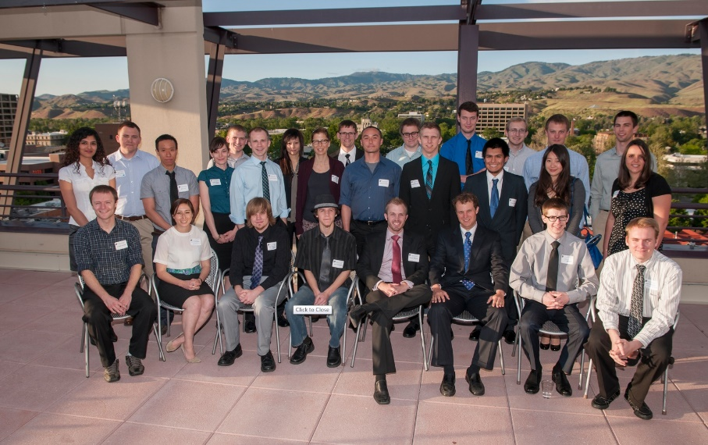








Industry Partnerships
IDOL + Expand.CS: 60 Scholarships Awards for 2014-18 totaling $534K
60 Internships

Slide 4
Degrees Offered
B.S. and M.S. in Computer Science
Cybersecurity and Secondary Education tracks
Second B.S. degree in Computer Science
PhD Program – 3 tracks (Computer Science, Cybersecurity, Computational Science & Engineering)
MS in STEM Education (CS Emphasis) and Graduate Certificate for CS High School Teachers

Slide 5
Department Facts and Figures
98 Bachelors degrees in 2017-18
Near 100% job placement
90% accepted jobs in Boise Metro area
Students score in top 10-20% in National Major Field Test for CS (compared to ~200 other departments)
Starting salaries range from $60-80K w/average around $72K
~80% of juniors/seniors have internships at local software companies

Slide 6
Department Growth Since 2012
Number of faculty increased from 8 to 26
Made twelve offers to first choice faculty candidate last year, of which eleven were accepted!
Budget has increased more than 3x
Amount of research funding up 40x
Retention in CS I course up from 66% to 85%
Faculty strengths in software engineering, data science, cybersecurity and HCI

Slide 7
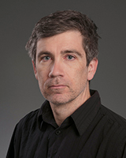
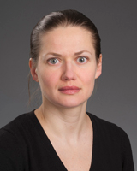
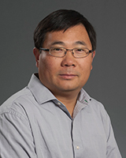
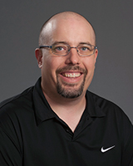
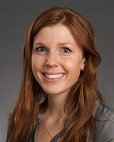
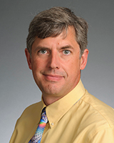
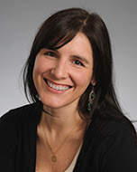
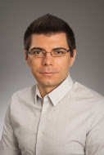
Steve Cutchin
Elena Sherman
Dianxiang Xu
Shane Panter
Sole Pera
Bogdan Dit
Marissa Schmidt
Matt Thomas

Slide 8
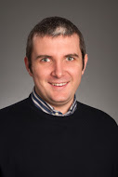
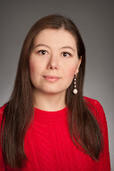
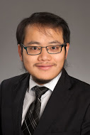
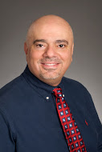
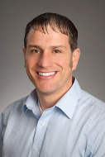
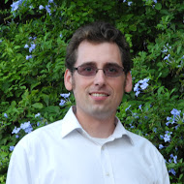
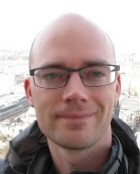
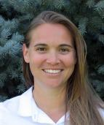
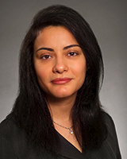
Edoardo Serra
Francesca Spezzano
Jidong Xiao
Gaby Dagher
Jerry Fails
Michael Ekstrand
Casey Kennington
Cathie Olschanowsky
Hoda Mehrpouyan

